Slide 1
Frequency Polygons
Full lesson PowerPoint, including I Do, We Do, You Do Example Sheet(s).

Slide 2
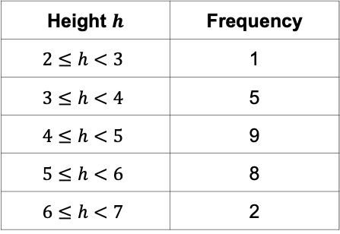
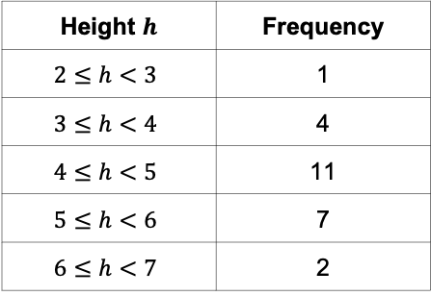
Drawing a Frequency Diagram from Table
WE DO | YOU DO
The data below represents the height of some students in a Year 7 class measured in feet. Complete the Frequency Chart using the information given.
Height $h$ | Frequency
$$2≤h<3$$ | 1
$$3≤h<4$$ | 4
$$4≤h<5$$ | 11
$$5≤h<6$$ | 7
$$6≤h<7$$ | 2
Height $h$ | Frequency
$$2≤h<3$$ | 1
$$3≤h<4$$ | 5
$$4≤h<5$$ | 9
$$5≤h<6$$ | 8
$$6≤h<7$$ | 2

Slide 3
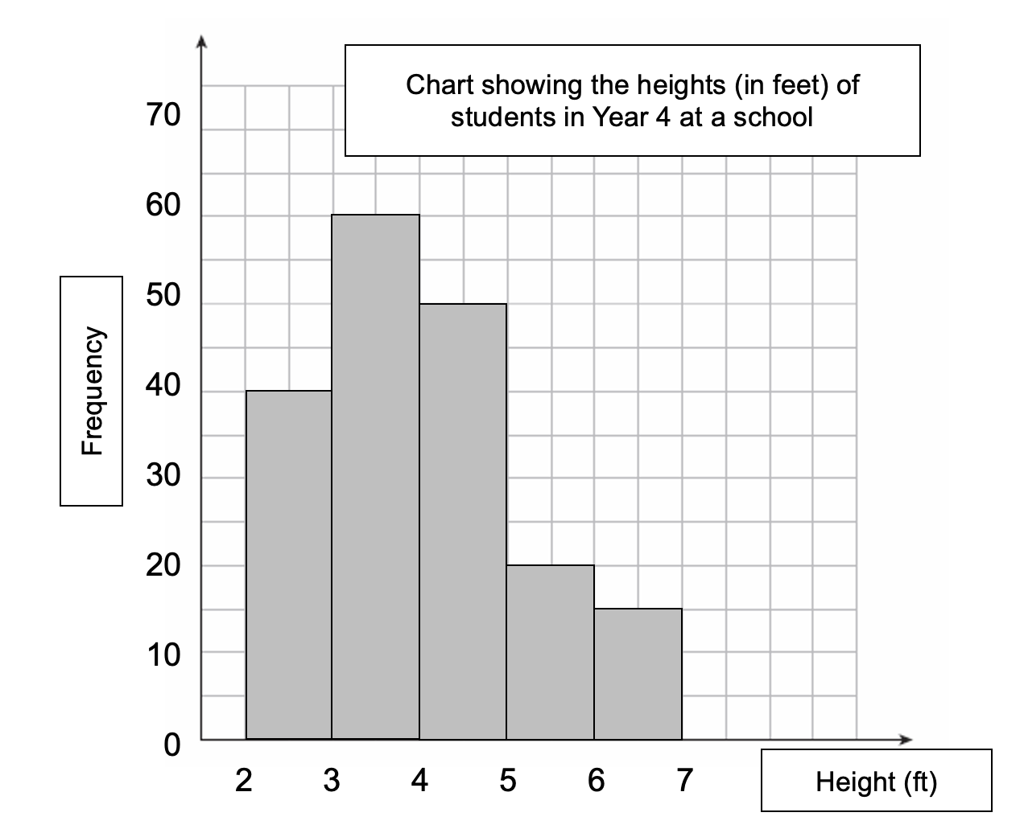
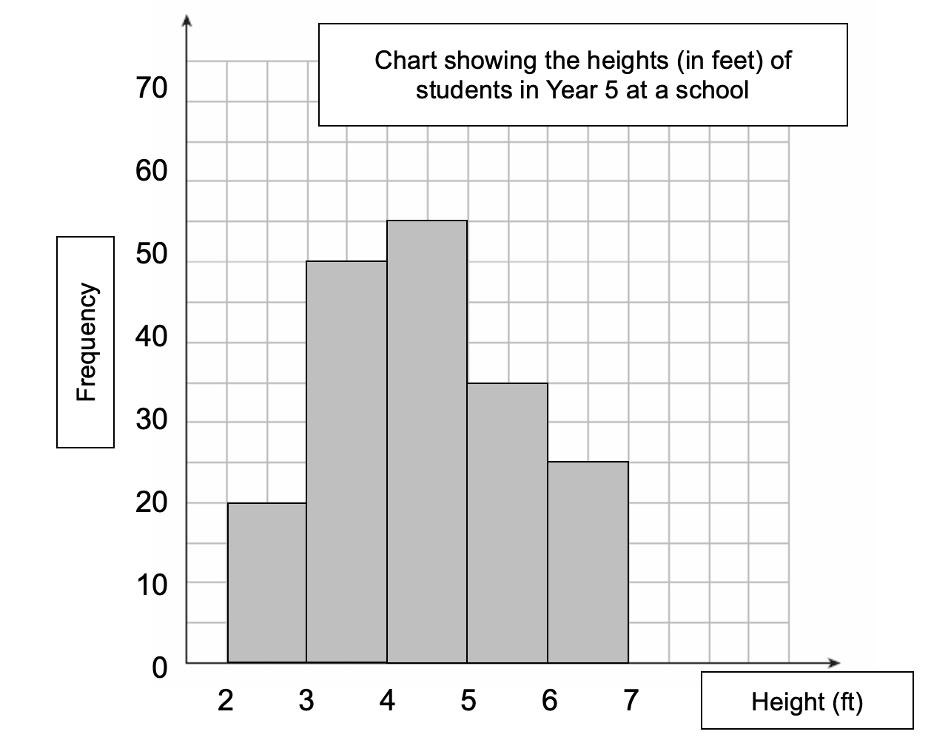
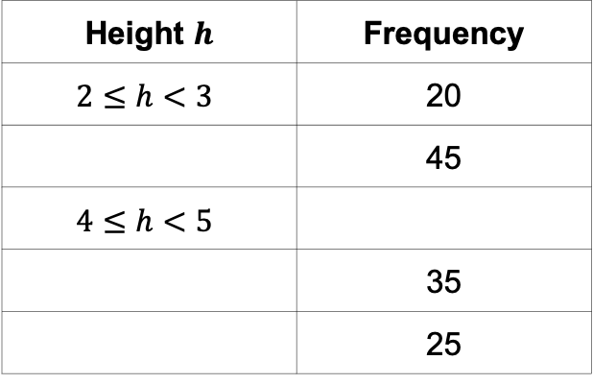
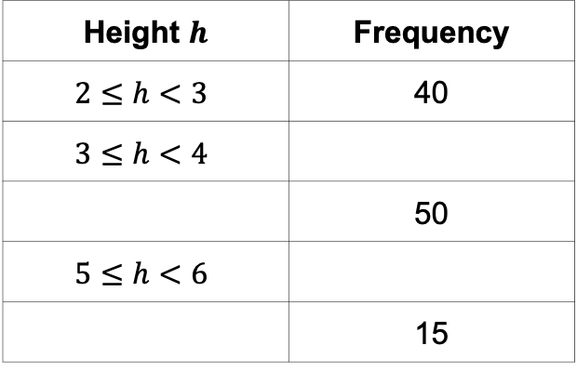
Interpreting a Frequency Diagram from Table
WE DO | YOU DO
Complete the frequency table for each frequency chart below.
Height $h$ | Frequency
$$2≤h<3$$ | 40
$$3≤h<4$$
 | 50
$$5≤h<6$$
 | 15
Height $h$ | Frequency
$$2≤h<3$$ | 20
 | 45
$$4≤h<5$$
 | 35
 | 25

Slide 4
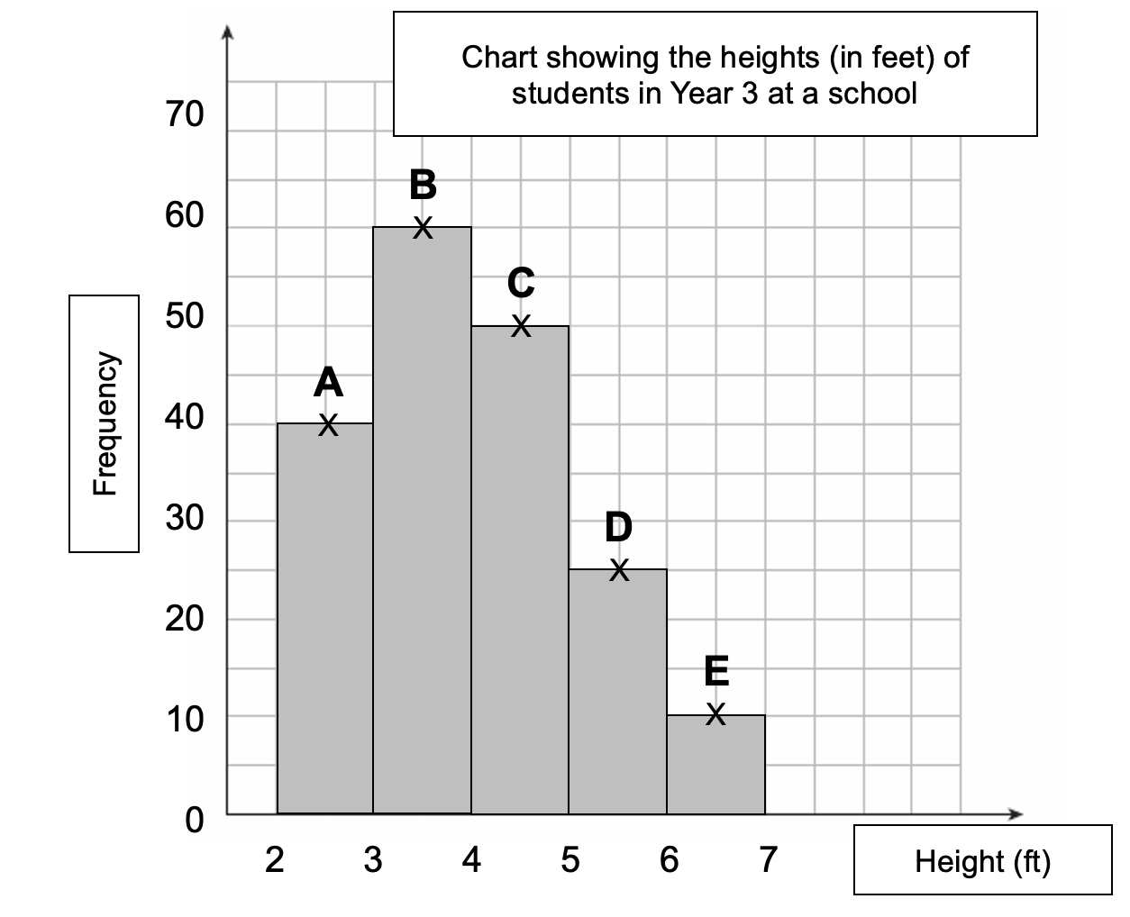
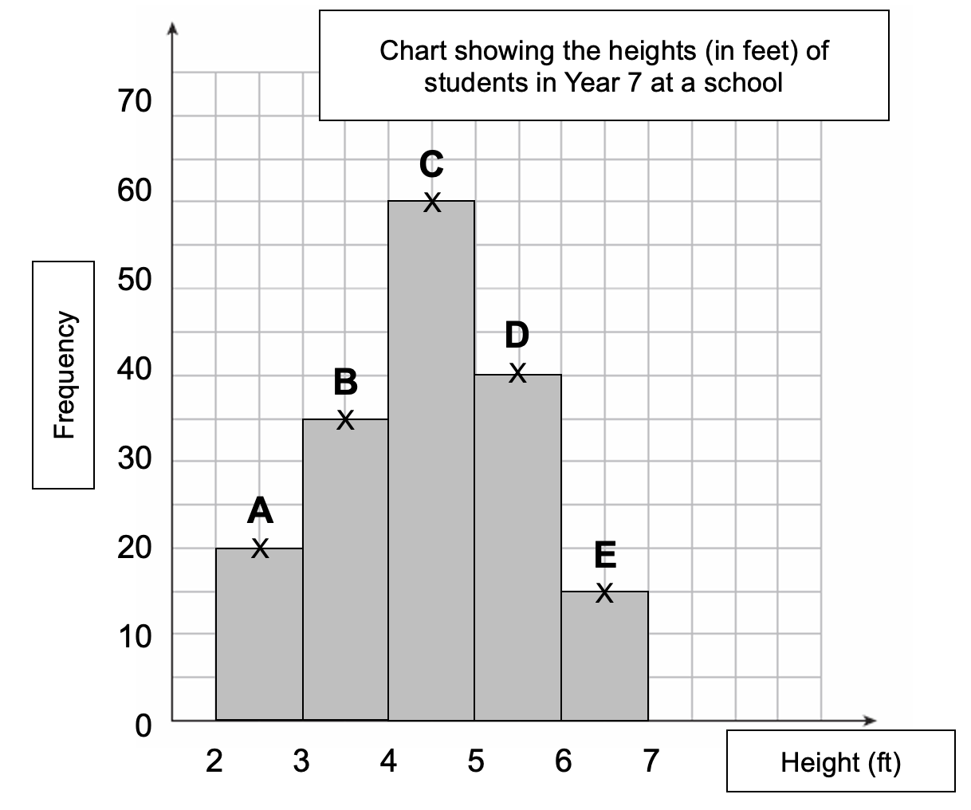
Plotting a Frequency Polygon (1)
WE DO | YOU DO
Write down to co-ordinates of each of the points A to F. What do you notice about where each of the points are marked? Add the frequency polygon to the chart. | Write down to co-ordinates of each of the points A to F. What do you notice about where each of the points are marked? Add the frequency polygon to the chart.
A ( , ) | B ( , ) | C ( , )
D ( , ) | E ( , )
A ( , ) | B ( , ) | C ( , )
D ( , ) | E ( , )

Slide 5
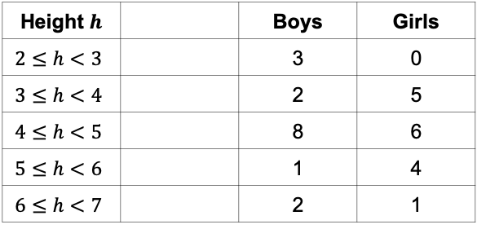
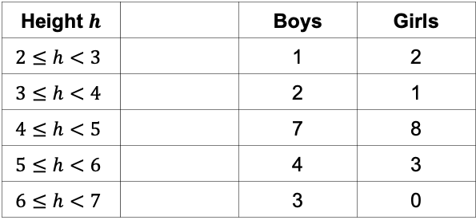
Plotting a Frequency Polygon (2)
WE DO | YOU DO
The data below represents the height of some students in two Year 6 classes (6A and 6B) measured in feet. Draw two frequency diagrams on each axes below, one for boys and one for girls.
Class 6A | Class 6B
Height $h$ |  | Boys | Girls
$$2≤h<3$$ |  | 1 | 2
$$3≤h<4$$ |  | 2 | 1
$$4≤h<5$$ |  | 7 | 8
$$5≤h<6$$ |  | 4 | 3
$$6≤h<7$$ |  | 3 | 0
Height $h$ |  | Boys | Girls
$$2≤h<3$$ |  | 3 | 0
$$3≤h<4$$ |  | 2 | 5
$$4≤h<5$$ |  | 8 | 6
$$5≤h<6$$ |  | 1 | 4
$$6≤h<7$$ |  | 2 | 1

Slide 6
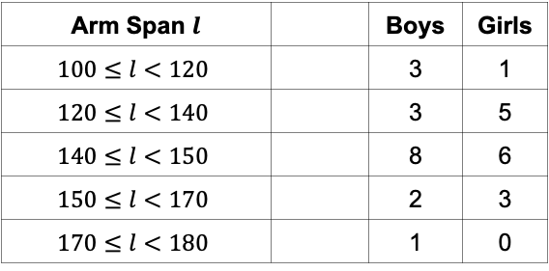
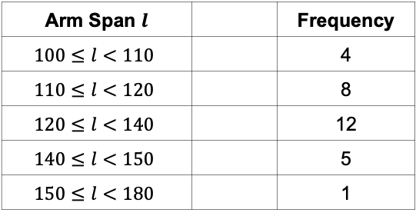
Plotting a Frequency Polygon (3)
WE DO | YOU DO
The data below represents the arm span of some students in two Year 6 classes (6A and 6B) measured in cm. Draw two frequency diagrams on each axes below, one for boys and one for girls.
Class 6A | Class 6B
Arm Span $l$ |  | Frequency
$$100≤l<110$$ |  | 4
$$110≤l<120$$ |  | 8
$$120≤l<140$$ |  | 12
$$140≤l<150$$ |  | 5
$$150≤l<180$$ |  | 1
Arm Span $l$ |  | Boys | Girls
$$100≤l<120$$ |  | 3 | 1
$$120≤l<140$$ |  | 3 | 5
$$140≤l<150$$ |  | 8 | 6
$$150≤l<170$$ |  | 2 | 3
$$170≤l<180$$ |  | 1 | 0

