Slide 1
Time-Series Graphs
Full lesson PowerPoint, including I Do, We Do, You Do Example Sheet(s).

Slide 2
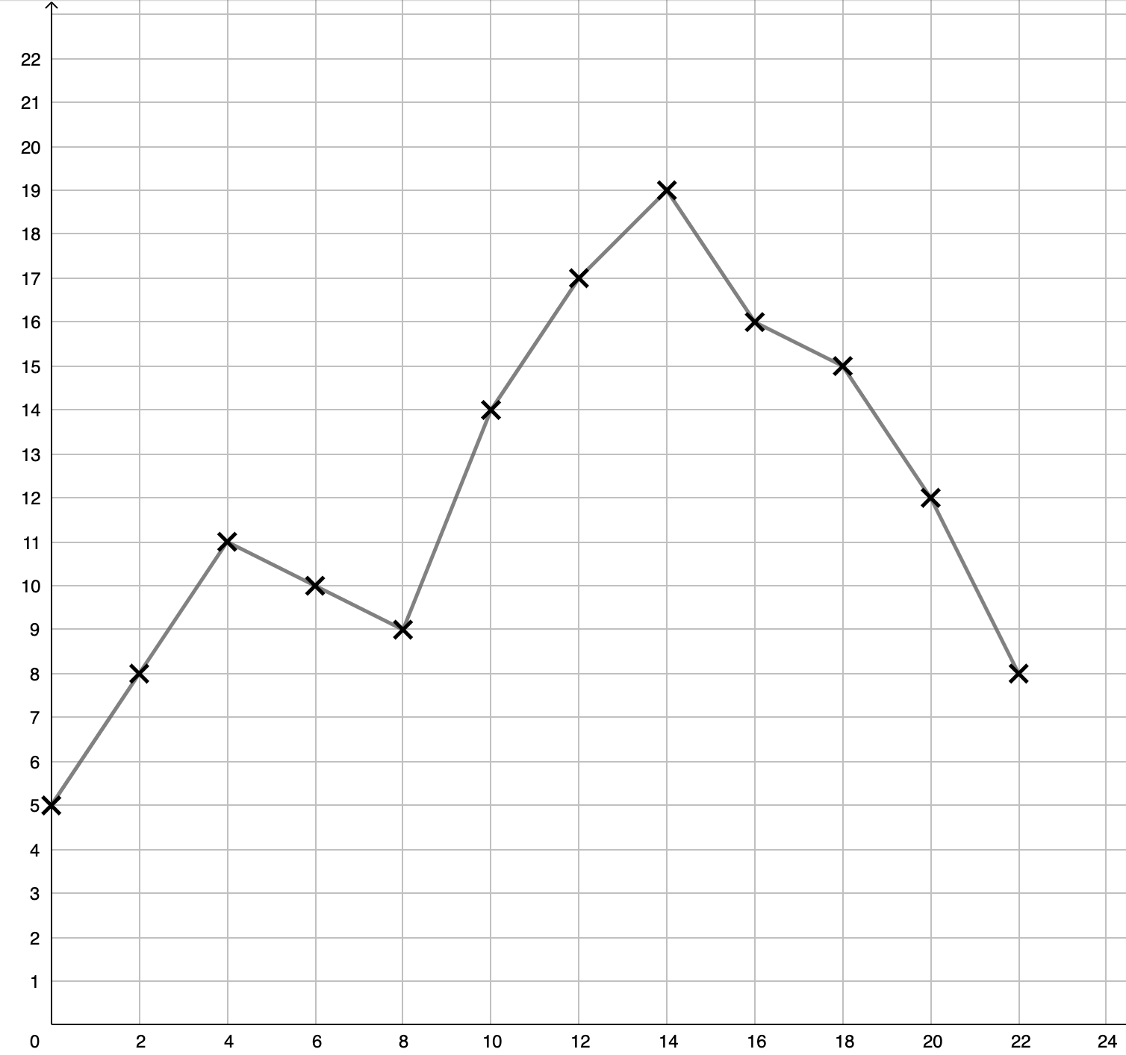
Interpreting a Time-Series Graph
WE DO |  | YOU DO
The Time-Series Graph below shows the temperature every two hours for a town in the UK
At what time was the temperature 9ºC? What was the hottest temperature recorded that day? What was the range of temperatures recorded? What do you think happened at around 08:00? |  |  | At what time was the temperature 11ºC? What was the coldest temperature recorded that day? What was the most common temperature recorded? During which month(s) do you think this data was taken? Why?
Temp (ºC)
Time

Slide 3
Plotting a Time-Series Graph
WE DO | YOU DO
The tables below show the temperature every four hours for towns in the UK. Plot the time-series graphs.
 | Two towns’ data is below. Plot both on the same axes below.
Time | 00:00 | 04:00 | 08:00 | 12:00 | 16:00 | 20:00 | 00:00 (+1day)
Temp (ºC) | 8 | 11 | 13 | 17 | 16 | 9 | 5
Time | 00:00 | 04:00 | 08:00 | 12:00 | 16:00 | 20:00 | 00:00 (+1day)
Town A Temp | 6 | 9 | 11 | 15 | 14 | 7 | 3
Town B Temp | 3 | 8 | 14 | 19 | 19 | 11 | 0
Temp (ºC)
Temp (ºC)
Time
Time

Slide 4
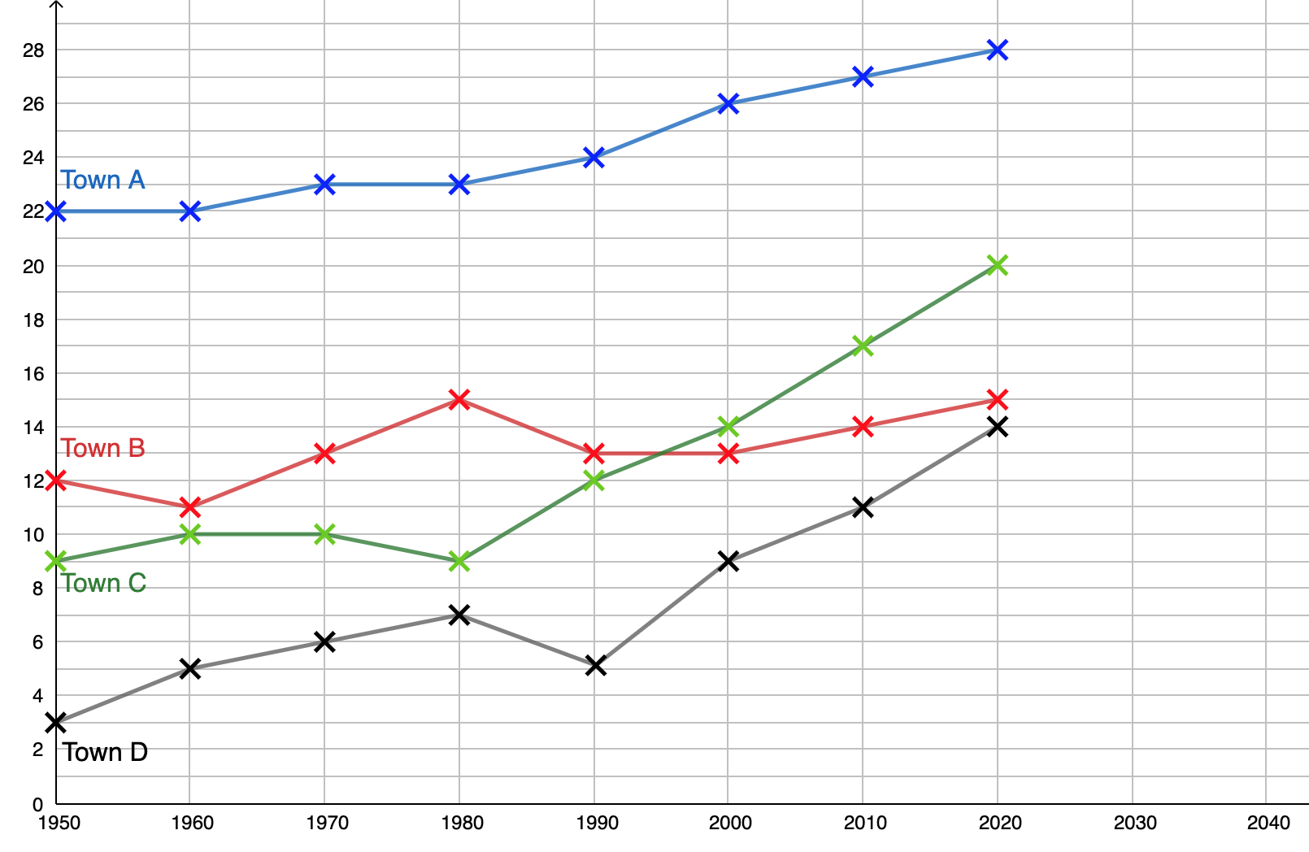
Trends in Time-Series Graphs
I DO | WE DO |  | YOU DO
The time-series graphs shows the average December temperatures in four cities between 1950 – 2020. For each graph:
Answer the We Do and You Do questions in your books. |  | Extension: Compare and contrast the data for each town.
a Describe the trend of the graph | b Write where in the world you think the city is
c Calculate the difference between the highest and lowest temperatures | d Plot where you think the next two points will be.
Temp (ºC)
Year

