Slide 1
Simplifying Expressions
I Do, We Do, You Do Example Sheets.

Slide 2
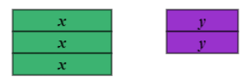
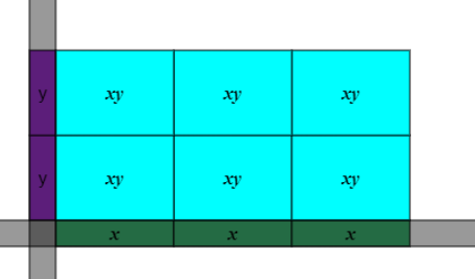
Simplifying expressions
I DO | WE DO | YOU DO
Simplify the following: 1) $3x+2y$ 2) $3x ×2y$ | Simplify the following: 1) $2x ×3y$ 2) $4x ×3y$ 3) $4x ×−3y$ | Simplify the following: 1) $5x ×2y$ 2) $2x ×5y$ 3) $5y ×2x$ 4) $−3x ×7y$ 5) $−3x ×−7y$
?
?
?
?

Slide 3
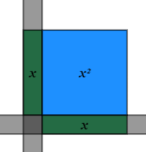
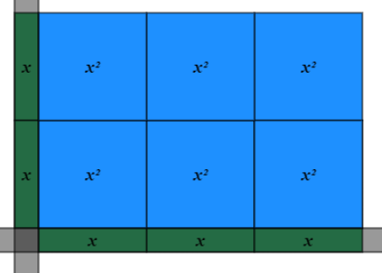
Simplifying expressions
I DO | WE DO | YOU DO
Simplify the following: 1) $x ×x$ 2) $3x ×2x$ | Simplify the following: 1) $2x ×3x$ 2) $4x ×3x$ 3) $4x ×−3x$ | Simplify the following: 1) $5x ×2x$ 2) $2x ×5x$ 3) $4x ×2x$ 4) $−3x ×7x$ 5) $−3x ×−7x$
?
?
?
?

Slide 4
Simplifying expressions
I DO | WE DO | YOU DO
Simplify the following: 1) $x ×x ×x$ 2) $3x ×2x ×4x^{2}$ | Simplify the following: 1) $x ×x ×x ×x$ 2) $4x^{2}×5x$ 3) $4x^{2} y ×−3x$ | Simplify the following: 1) $5x^{2} ×2x$ 2) $2x^{2} ×5x$ 3) $4x^{2} ×2y$ 4) $−3x^{2} ×7x$ 5) $−3x^{2} ×−7x^{2} ×2y$
?
?
?
?

Slide 5
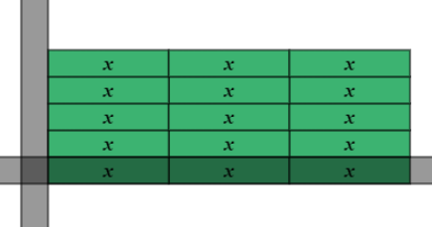
Simplifying expressions
I DO | WE DO | YOU DO
Simplify the following: 1) $12x ÷3$ 2) $12x ÷3x$ | Simplify the following: 1) $15x ÷3$ 2) $15x ÷3x$ 3) $28x ÷−4x$ | Simplify the following: 1) $18x ÷9$ 2) $18x ÷9x$ 3) $21x ÷−7$ 4) $21x ÷−7x$ 5) $−24x ÷−6$
?
?
?
?

Slide 6
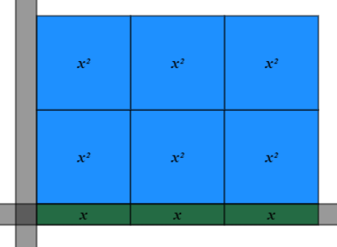
Simplifying expressions
I DO | WE DO | YOU DO
Simplify the following: 1) $6x^{2} ÷3x$ 2) $6x^{3} ÷3x$ | Simplify the following: 1) $15x^{2} ÷3x$ 2) $15x^{2} ÷3x^{2}$ 3) $28x^{3} ÷−4x$ | Simplify the following: 1) $18x^{2} ÷9$ 2) $18x^{2} ÷9x$ 3) $21x^{3} ÷−7$ 4) $21x^{3} ÷−7x$ 5) $−24x^{5} ÷−6$
?
?
?
?

