Slide 1
 |  |  | Completing the Square – Solving a=1
Learning Outcomes
 | I need help using Algebra Tiles
 | I can recognise a completing the square question (Grade 6)
 | I can write an expression in the form ${\left(x+p\right)}^{2}+q$ (Grade 6+)
 | I can solve an equation after completing the square (Grade 7)
 | I can use completing the square to identify key points, including: roots and turning points (Grade 7+)

Slide 2
Solving Using the Completing the Square
I DO | WE DO | YOU DO
Write the equation $x^{2}+4x+1$ in the form ${\left(x+p\right)}^{2}+q$. Hence, solve the equation $x^{2}+4x+1=0$ | Write the equation $x^{2}−6x+7$ in the form ${\left(x+p\right)}^{2}+q$. Hence, solve the equation $$x^{2}−6x+7=0$$ | ANSWER IN YOUR BOOKS For each of the equations below: Write the equation in the form ${\left(x+p\right)}^{2}+q$. Hence solve the equation. $x^{2}+6x+1$ $x^{2}+8x+1$ $$x^{2}+8x+3$$ $$x^{2}−8x+3$$ $$x^{2}−8x+13$$ $$x^{2}−10x+13$$ $$x^{2}−9x+13$$ $$x^{2}−9x+\frac{13}{2}$$ $$x^{2}−9x+\frac{13}{4}$$

Slide 3
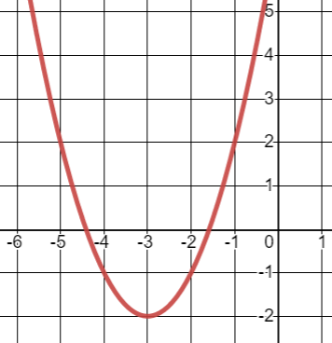
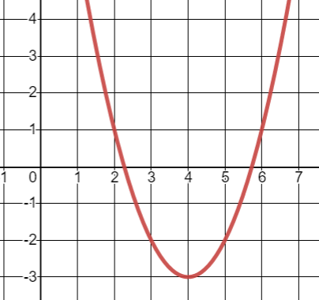
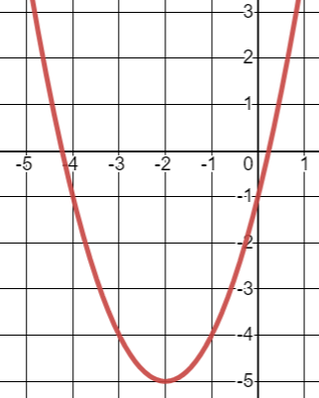
Solving Using the Completing the Square
I DO | WE DO | YOU DO
Write the equation $x^{2}+6x+7$ in the form ${\left(x+p\right)}^{2}+q$. Here is the graph of $x^{2}+6x+7$. What do you notice about the turning point. Hence, solve the equation. | Write the equation $x^{2}−8x+13$ in the form ${\left(x+p\right)}^{2}+q$. Here is the graph of $x^{2}−8x+13.$ What do you notice about the turning point. Hence, solve the equation. | Write the equation $x^{2}+4x−1$ in the form ${\left(x+p\right)}^{2}+q$. Here is the graph of $x^{2}+4x−1$. What do you notice about the turning point. Hence, solve the equation.

