Slide 1

Plotting Quadratic Graphs from Key Points
Full lesson PowerPoint, including I Do, We Do, You Do Example Sheet(s).

Slide 2
 | Plotting Quadratic Graphs from Key Points

Slide 3
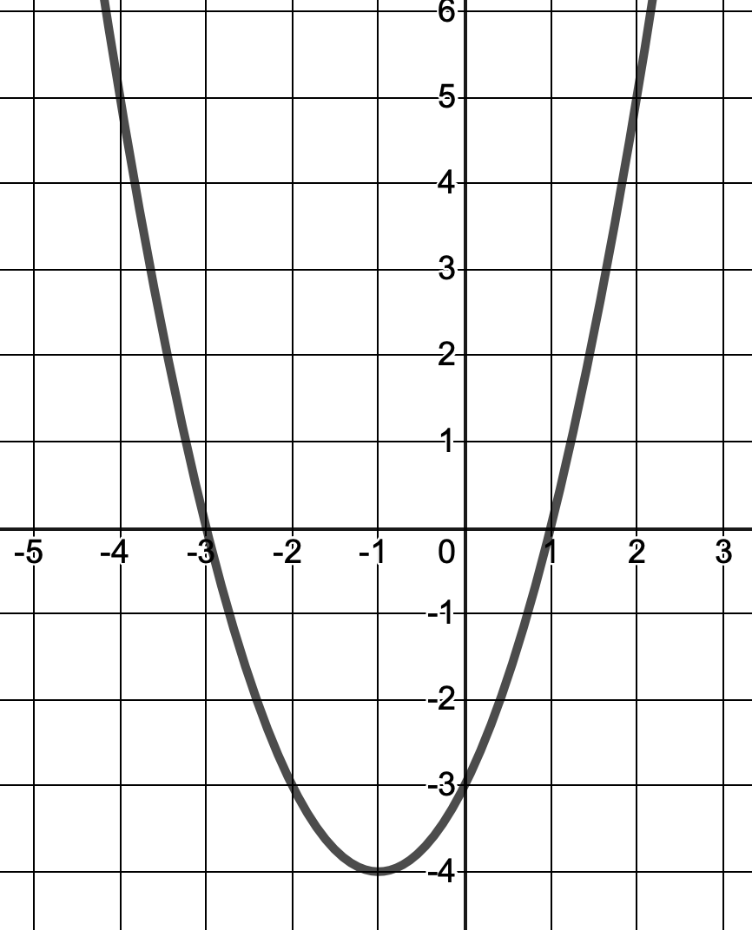
Key Definitions
Equation of Line of Symmetry
Normally in the form x = ...
Roots
The roots of an equation are where the graph crosses the x-axis
y-intercept
The point where the graph crosses the y-axis.
Turning Point
The coordinates at which the curve is at its maximum or minimum point.

Slide 4
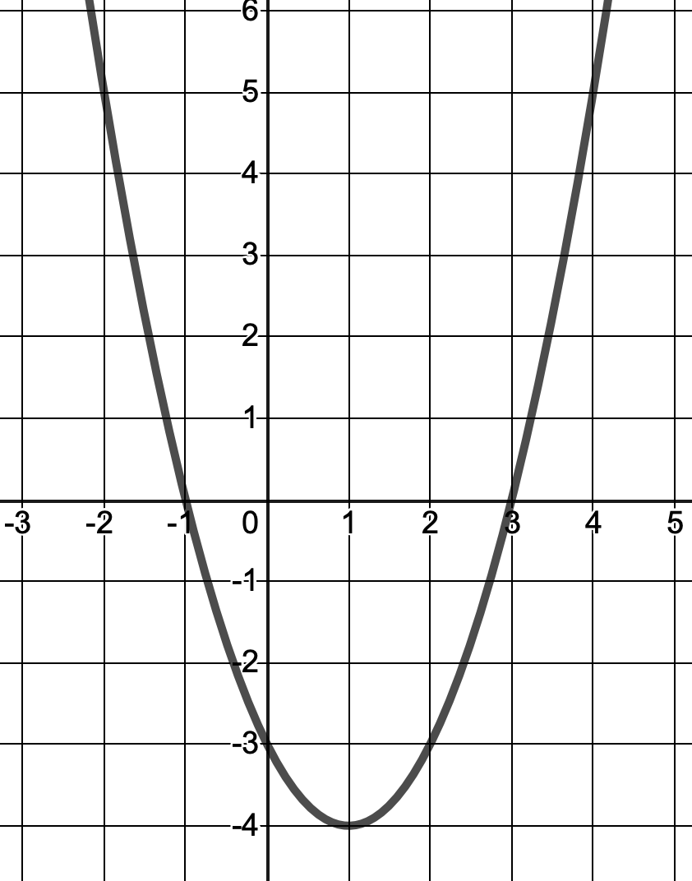
Identifying Key Features of a Quadratic Graph
I DO | WE DO
The diagram shows the graph for the quadratic equation y = x² + 2x - 3 Determine: The coordinates of the turning point The roots of the equation The equation of the line of symmetry | The diagram shows the graph for the quadratic equation y = x² - 2x - 3 Determine: The coordinates of the turning point The roots of the equation The equation of the line of symmetry

Slide 5
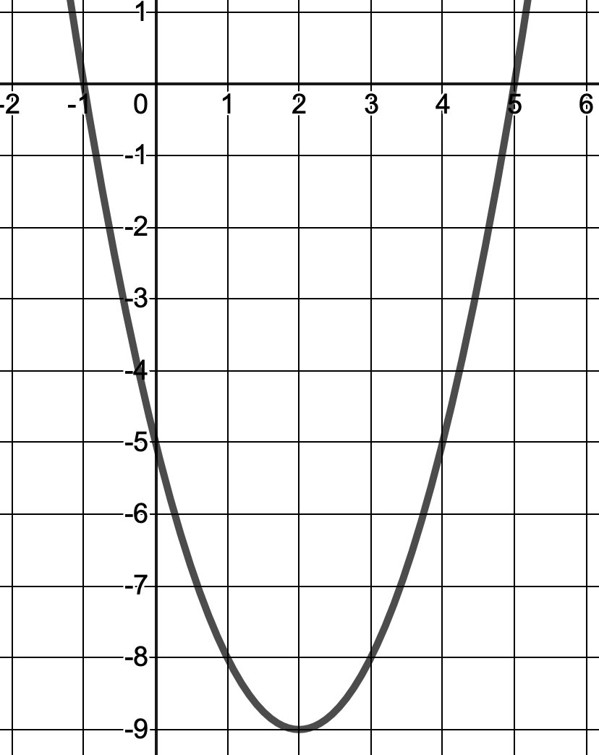
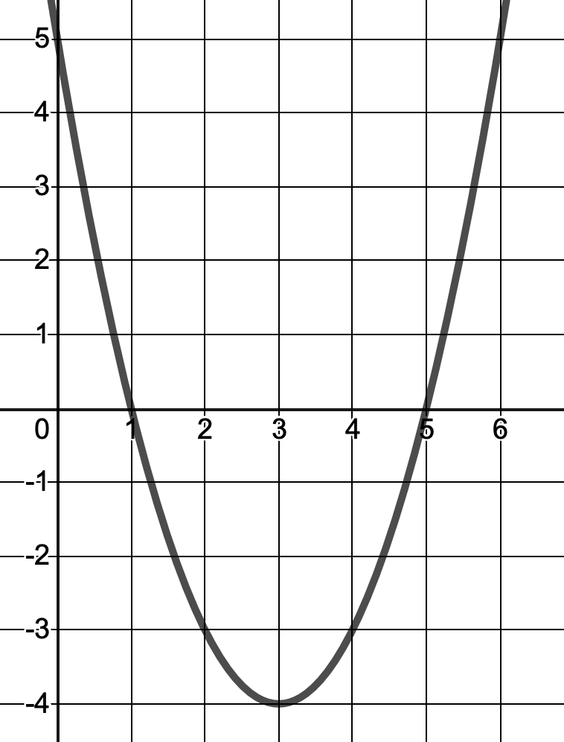
Identifying Key Features of a Quadratic Graph
YOU DO 1 | YOU DO 2
The diagram shows the graph for the quadratic equation y = x² - 4x - 5 Determine: The coordinates of the turning point The roots of the equation The equation of the line of symmetry | The diagram shows the graph for the quadratic equation y = x² - 6x + 5 Determine: The coordinates of the turning point The roots of the equation The equation of the line of symmetry
Extension: Use the graphs to produce a table of values for each of the I DO, WE DO and YOU DO graphs.

Slide 6
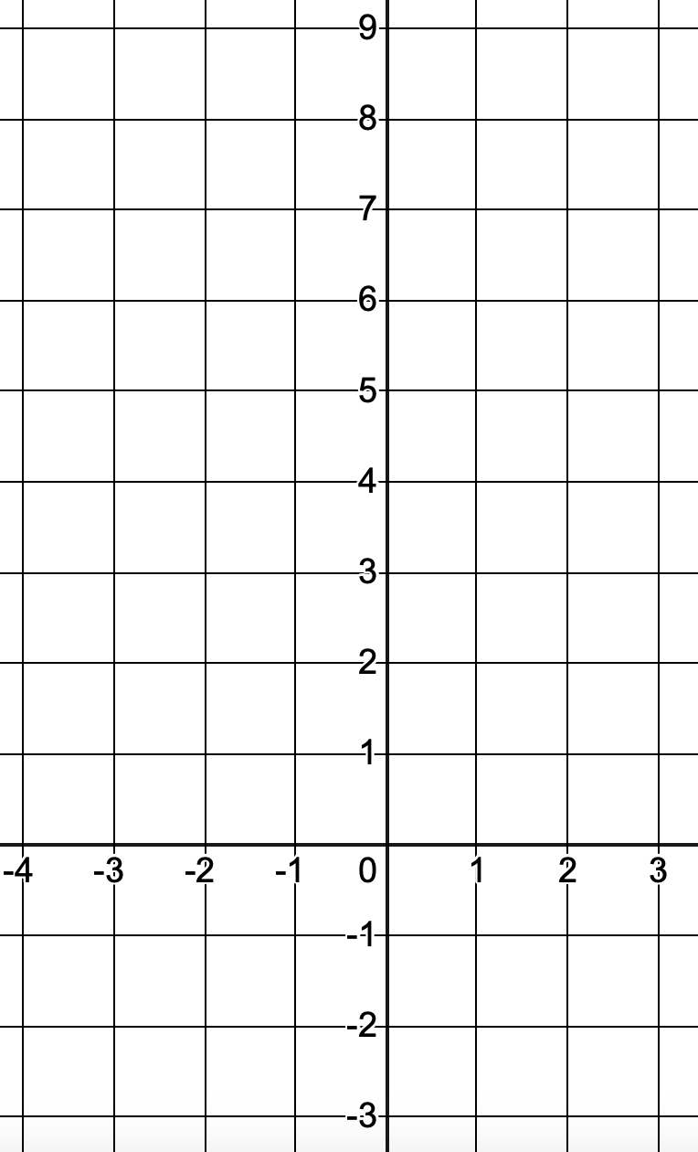
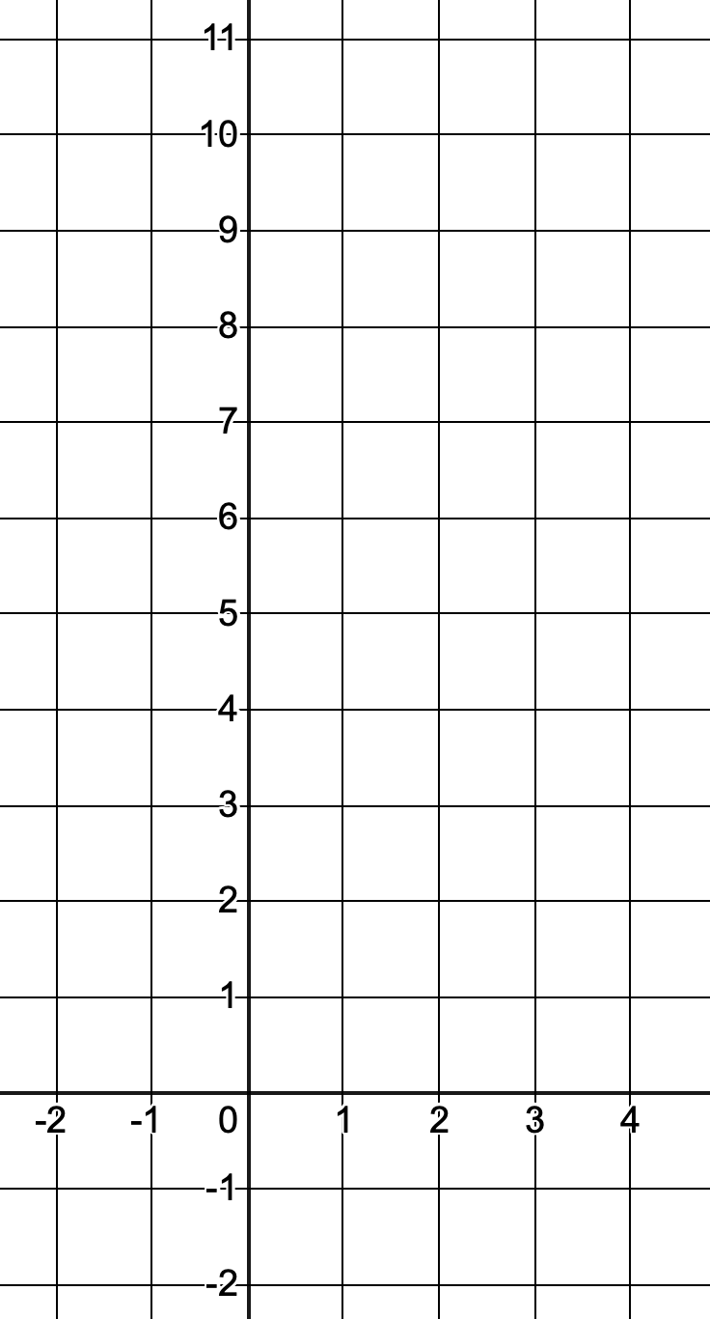
Identifying Key Features of a Quadratic Graph
I DO | WE DO | YOU DO
For each question below: a) Plot the graph for the values given b) Determine the number of real roots c) State/estimate the solutions to the equation if possible
y = x² + 2x + 1 for -4 ≤ x ≤ 2. | y = x² - 2x + 3 for -2 ≤ x ≤ 4. | ANSWER THESE IN YOUR BOOK. DRAW AN AXES FROM -10 TO 10 IN BOTH DIRECTIONS. i) y = x² - 4x + 3 for -1 ≤ x ≤ 5. ii) y = x² - 4x + 5 for -1 ≤ x ≤ 5. iii) y = x² + 4x + 3 for -5 ≤ x ≤ 1. iv) y = x² + 4x - 5 for -6 ≤ x ≤ 2.

Slide 7
