Slide 1
Inverse Proportion
Full lesson PowerPoint, including I Do, We Do, You Do Example Sheet(s).

Slide 2
Inverse Proportion (1)
I DO | WE DO | YOU DO
y is inversely proportional to x Work out the missing values in the table. What do you notice about each column? | y is inversely proportional to x Work out the missing values in the table. What do you notice about each column? | y is inversely proportional to x Work out the missing values in the table. What do you notice about each column?
x | 1 | 2
y | 100 |  | 25
x | 3 |  | 12
y | 120 | 40
x | 1 | 5 | 10
y | 250
x | 2 | 8 | 80
y | 80

Slide 3
Inverse Proportion (2)
I DO | WE DO | YOU DO
y is inversely proportional to x Work out the constant of proportionality (k) Find the missing values in the table Write an equation connecting x and y. | y is inversely proportional to x Work out the constant of proportionality (k) Find the missing values in the table Write an equation connecting x and y. | y is inversely proportional to x Work out the constant of proportionality (k) Find the missing values in the table Write an equation connecting x and y.
x | 1 | 2
y | 80 |  | 8
x |  | 9 | 12
y | 120 | 40
x | 1 | 2
y | 40 |  | 5
x | 2 | 4
y |  | 30 | 5

Slide 4
Inverse Proportion (3)
I DO | WE DO | YOU DO
y is inversely proportional to x When x = 2, y = 50. Work out the value of y when x = 20. Work out the value of x when y = 12.5 | y is inversely proportional to x When x = 5, y = 50. Work out the value of y when x = 10. Work out the value of x when y = 25 | y is inversely proportional to x When x = 4, y = 50. Work out the value of y when x = 2. Work out the value of x when y = 12.5 y is inversely proportional to x When x = 6, y = 100. Work out the value of y when x = 48 Work out the value of x when y = 25

Slide 5
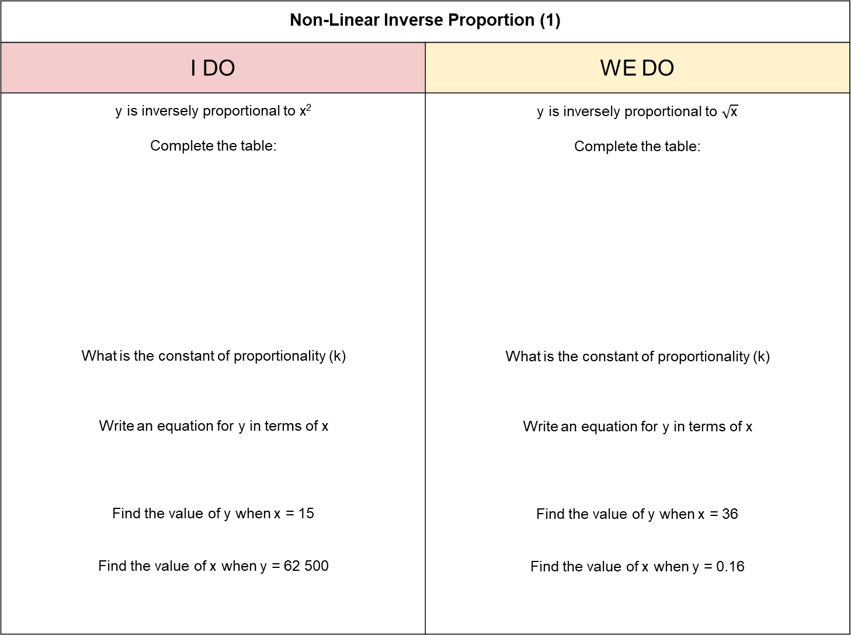
Non-Linear Inverse Proportion (1)
I DO | WE DO
y is inversely proportional to x² Complete the table: What is the constant of proportionality (k) Write an equation for y in terms of x Find the value of y when x = 15 Find the value of x when y = 62 500 | y is inversely proportional to $\sqrt{\text{x}}$ Complete the table: What is the constant of proportionality (k) Write an equation for y in terms of x Find the value of y when x = 36 Find the value of x when y = 0.16
x | 1 | 5 | 8
y | 100 | 4
x | 1 | 9 |  | 25
y | 4 | $$\frac{\text{4}}{\text{3}}$$ | 1

Slide 6
Non-Linear Inverse Proportion (2)
I DO | WE DO
y is inversely proportional to the cube of x When x = 2 y = 5. Find the value of y when x = 4 Find the value of x (to 2dp) when y = 8. | y is inversely proportional to the square root of x When x = 4 y = 32. Find the value of y when x = 100 Find the value of x when y = 10.

