Slide 1
Unitary Method
Full lesson PowerPoint, including I Do, We Do, You Do Example Sheet(s).

Slide 2
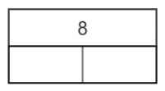
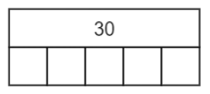
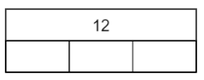
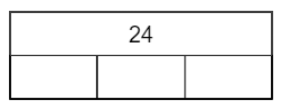
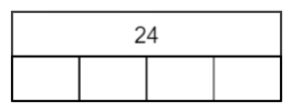
Unitary Method
I DO | WE DO | YOU DO
Work out the value of each empty block. | Work out the value of each empty block. | Work out the value of each empty block. 1) 2) 3)

Slide 3
Unitary Method
I DO | WE DO | YOU DO
If two toys cost £8. How much is it for 1 toy? | If five toys cost £30. How much is it for 1 toy? | 1) If three toys cost £12. How much is it for 1 toy? 2) If three toys cost £24. How much is it for 1 toy? 3) If four toys cost £24. How much is it for 1 toy? 4) If six toys cost £48. How much is it for 1 toy?

Slide 4
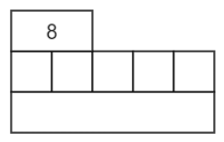
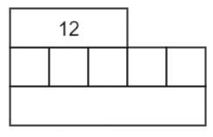
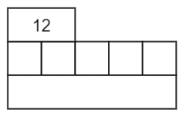
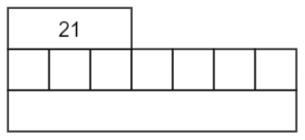
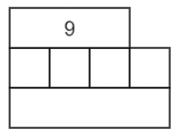
Unitary Method
I DO | WE DO | YOU DO
Work out the value of each empty block. | Work out the value of each empty block. | Work out the value of each empty block. 1) 2) 3)

Slide 5
Unitary Method
I DO | WE DO | YOU DO
If three toys cost £12. How much is it for five toys? | If two toys cost £12. How much is it for 5 toys? | 1) If two toys cost £8. How much is it for five toys? 2) If three toys cost £21. How much is it for seven toys? 3) If three toys cost £9. How much is it for four toys? 4) If seven toys cost £63. How much is it for twelve toys?

Slide 6
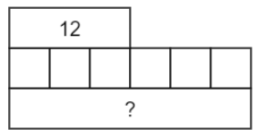
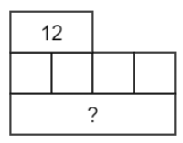
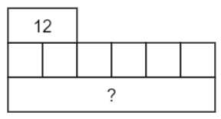
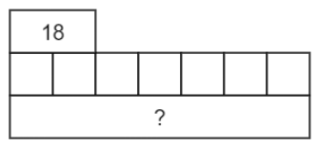
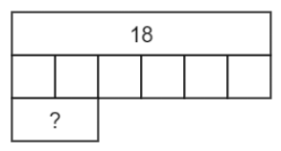
Unitary Method
I DO | WE DO | YOU DO
Is the unitary method always the most efficient? Work out the value of the “?”. or | Work out the value of the “?”. | Work out the value of the “?”. 1) 2) 3)

Slide 7
Unitary Method
I DO | WE DO | YOU DO
If two toys cost £12. How much is it for four toys? | If two toys cost £12. How much is it for six toys? | 1) If three toys cost £12. How much is it for six toys? 2) If two toys cost £18. How much is it for seven toys? 3) If six toys cost £18. How much is it for two toys? 4) If four toys cost £14. How much is it for fourteen toys?

