Slide 1
Plotting Linear Graphs
Full lesson PowerPoint, including I Do, We Do, You Do Example Sheet(s).

Slide 2
 | Plotting Linear Graphs

Slide 3
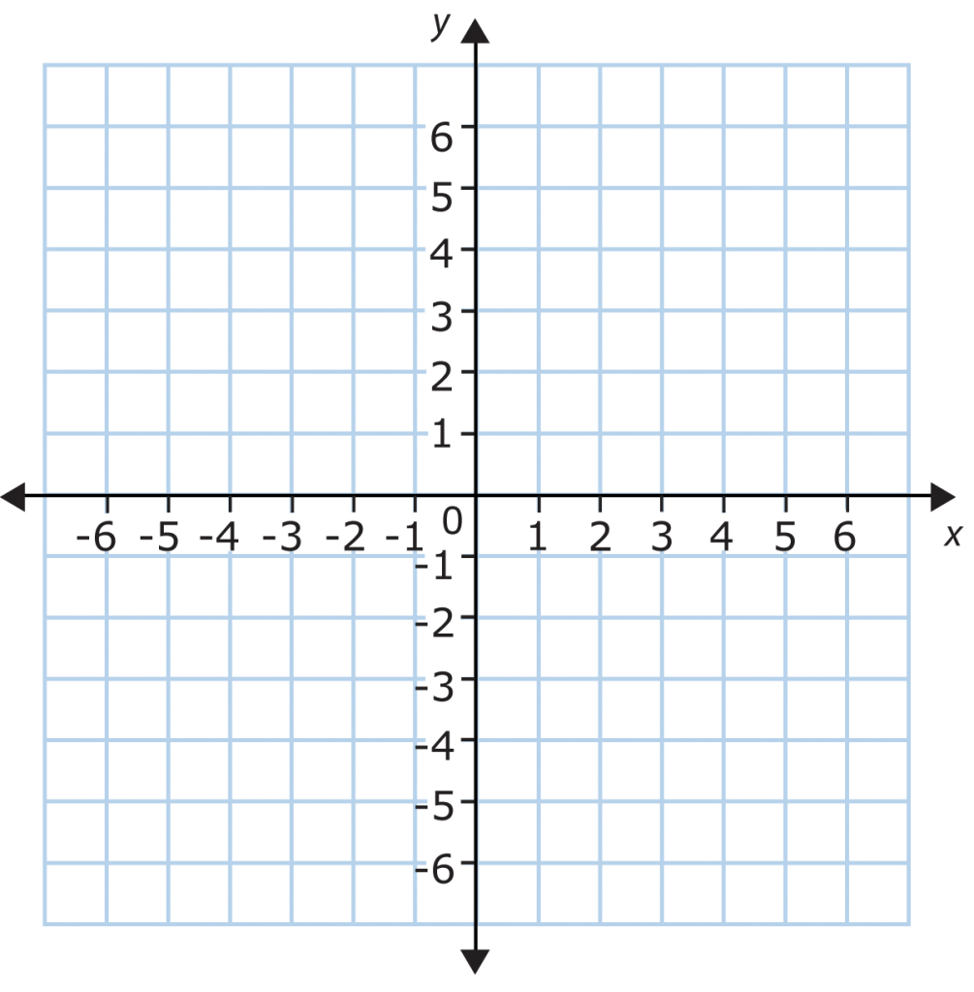
Plotting a Linear Graph from Table of Values (Positive Gradient)
I DO | WE DO | YOU DO
Use the table of values below to plot the graph on the axis. Label your graph. | Use the table of values below to plot the graph on the axis. Label your graph. | Use the table of values below to plot the graph on the axis. Label your graph.
x | -2 | -1 | 0 | 1 | 2
y | -4 | -1 | 2 | 5 | 8
x | -2 | -1 | 0 | 1 | 2
y | -2 | 0 | 2 | 4 | 6
x | -2 | -1 | 0 | 1 | 2
y | -9 | -5 | -1 | 3 | 7

Slide 4
Plotting a Linear Graph from Table of Values (Negative Gradient)
I DO | WE DO | YOU DO
Use the table of values below to plot the graph on the axis. Label your graph. | Use the table of values below to plot the graph on the axis. Label your graph. | Use the table of values below to plot the graph on the axis. Label your graph.
x | -2 | -1 | 0 | 1 | 2
y | 7 | 5 | 3 | 1 | -1
x | -2 | -1 | 0 | 1 | 2
y | 9 | 6 | 3 | 0 | -3
x | -3 | -2 | -1 | 0 | 1
y | 5 | 2 | -1 | -4 | -7

Slide 5
Plotting a Linear Graph from Table of Values (Negative Gradient)
WE DO |  | YOU DO
Plot the graph of y = 4x - 1 | Plot the graph of y = 4x + 1 | Use the table of values you completed on the earlier I DO, WE DO, YOU DO Sheets to plot the graphs on the axes below. Clearly label each line. Plot two graphs on each axes.

